Slide 1


Ebenezer Baptist Church
Teamwork
Faith – Focused - Forward
Church Meeting
Tuesday June 30, 2026

Slide 2
Faith – Focused – Forward
Conference Purpose
To gather insights from ministry leaders so we can build a Strategic Plan that strengthens every major pillar of the Church Ministries, Missions, Finances, Leadership Development, and Administrative Operations for long‑term growth and sustainability.
“Commit to the Lord whatever you do, and he will establish your plans.” - Prov.16:3

Slide 3
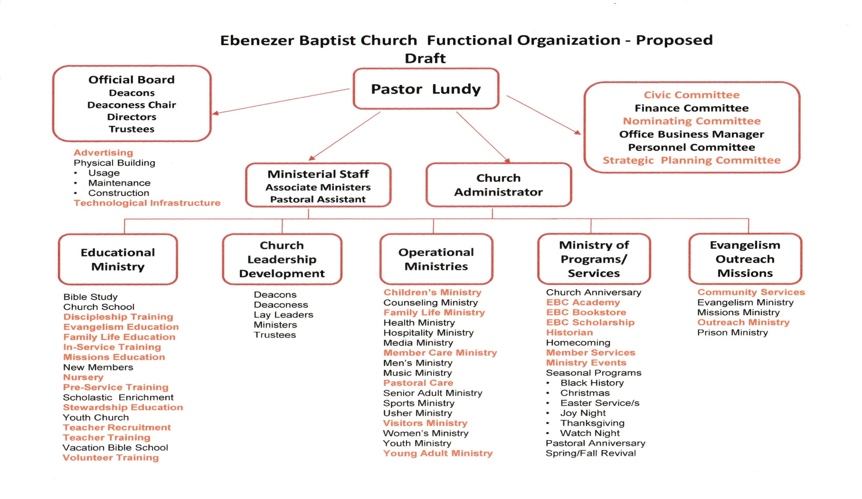
Faith – Focused – Forward
Proposed Future State

Slide 4
Faith – Focused – Forward
Focus
EBC Vision Recast
Review Actionable Objectives
Operational Processes (SOP’s)
Assign Actionable Objectives
What’s Next

Slide 5
Faith – Focused – Forward
Vision
Vision: is a clear, prayer inspired picture of the future God has called the ministry to pursue.
It provides direction, fosters unity, inspires commitment, guides decision-making, encourages growth, builds accountability, and strengthens our perseverance.
“ Where there is no vision, the people perish…” – Prov. 29:18

Slide 6
Faith – Focused – Forward
Vision
“ Vision sets You free from
the Limitations
of
What the eyes see and allows
You to
Enter the Liberty
of
what the heart can feel” - Myles Munroe

Slide 7
Faith – Focused – Forward
EBC Vision Recast
VISION: To be a Christ-centered, Spirit-empowered church where lives are transformed by the Gospel, believers are equipped for faithful service, families are strengthened by God's Word, our community is impacted by the love of Christ, and generations of disciples are nurtured through worship, fellowship, stewardship, and discipleship as we expand the ministry for the glory of God.

Slide 8
Faith – Focused – Forward
EBC Vision Recast
MISSION: The mission of Ebenezer Baptist Church is to glorify God by preaching and teaching the Gospel of Jesus Christ with such clarity and conviction that it reaches the youngest child, draws the greatest sinner, and challenges the most devoted saint to trust and obey Christ. We are committed to making faithful disciples through biblical teaching, authentic worship, Christ-centered fellowship, faithful stewardship, and compassionate service, while strengthening families, equipping men and women for ministry, nurturing children, and youth, and impacting our community for the glory of God until Christ returns.

Slide 9
Faith – Focused – Forward
EBC Vision Recast
PURPOSE: Ebenezer Baptist Church exists to glorify God by walking in faith, obeying His Word, and fulfilling the work He has assigned to us: to build up the Body of Christ, to expand our capacity for ministry through service, to strengthen families through biblical discipleship, and to serve as a beacon of hope in a culture increasingly hostile to faith. Empowered by the Holy Spirit, we commit to labor without retreat until the vision God has given becomes reality.

Slide 10
Faith – Focused – Forward
Actionable Objectives
Preparing for Changing Technology and Culture
Action Item: Launch a “Digital Ministry & Innovation Team” to implement AI tools, improve online engagement, and expand discipleship through technology-based platforms.
2. Operational Process Improvements
Action Item: Implement a “Church Operations & Engagement Initiative” to improve the worship structure, strengthening member involvement, develop next-generation leadership pathways, coordinate targeted outreach to underserved, and disconnected communities, and regularly conducting a full ministry operational review to ensure organizational efficiencies.

Slide 11
Faith – Focused – Forward
Actionable Objectives
3. New Revenue Streams and Funding Models
Action Item: Create a “Kingdom Stewardship Task Force” to evaluate rental opportunities, community programs, and new giving initiatives.
4. Reaching Members in Physical and Virtual Spaces
Action Item: Develop an “E-Ministry & Digital Campus” that includes livestream engagement, online discipleship groups, and coordinated member and visitor follow-up.

Slide 12
Faith – Focused – Forward
Actionable Objectives
5. Updating Policies and Procedures
Action Item: Establish a “Constitutional & Policy Review Committee” to update bylaws, SOPs, leadership policies, and digital resource access training.
6. Training for Staff and Ministry Leaders
Action Item: Implement an annual “Leadership Development Institute” focused on staff and servant leadership, mentoring, team building, and ministry care.

Slide 13
Faith – Focused – Forward
Actionable Objectives
7. Engaging Children, Youth, Young Adults, and Families
Action Item: Launch a comprehensive “Youth & Family Engagement Initiative” that includes mentorship, youth leadership opportunities, family ministries, and targeted outreach.
8. Ensuring Ministry Thrives for the Next Generation
Action Item: Create a “Next Generation Ministry Strategy” that focuses on mentorship, inclusivity, life-stage ministries, outreach, and leadership succession planning.

Slide 14
Faith – Focused – Forward
Actionable Objectives
9. Addressing Social, Political, and Economic Challenges
Action Item: Form a “Media & Community Outreach Team” to produce weekly reels, promote ministries online, and coordinate neighborhood evangelism initiatives.
10. Addressing Emerging Spiritual Needs
Action Item: Develop a church-wide “Spiritual Growth & Leadership Pathway” that includes prayer training, mentoring programs, discipleship groups, and leadership onboarding.

Slide 15
Faith – Focused – Forward
Operational Processes (SOP’s)
What is a Standard Operating Procedure (SOP)?
A Standard Operating Procedure (SOP) is a set of step-by-step instructions outlining how tasks and processes should be carried out. It’s a powerful tool for streamlining administration, maintaining accountability, and ensuring smooth day-to-day operations and transition when leadership or volunteers change. An SOP will provide consistency, and accountability in ministry operations.

Slide 16
Faith – Focused – Forward
Operational Processes (SOP’s)
Why An SOP ?
Consistency & Efficiency – Ensures that church activities and programs follow a structured approach, reducing confusion and operational interruptions.
Accountability & Transparency – Clearly defines roles and responsibilities, ensuring that church leaders, staff, and volunteers operate within church policy.
Internal Communication – Provides a reference for church leaders and members, making internal communication more effective.

Slide 17
Faith – Focused – Forward
Operational Processes (SOP’s)
Why An SOP?
Smoother Transitions – Simplifies onboarding of new staff, volunteers, or leadership changes by offering a structured guide for church operations.
Administrative Operations - SOP’s cover leadership, administration, finances, worship services & programs, volunteers, facilities, security, outreach and compliance, safety policies, and other legal considerations.
To stay aligned with the church’s mission, to keep up with operational changes and to adapt to ministry growth each SOP should be review annually.
The main purpose of the SOP is to protect the ministry, empower the people, and create consistency in operations within the church.

Slide 18
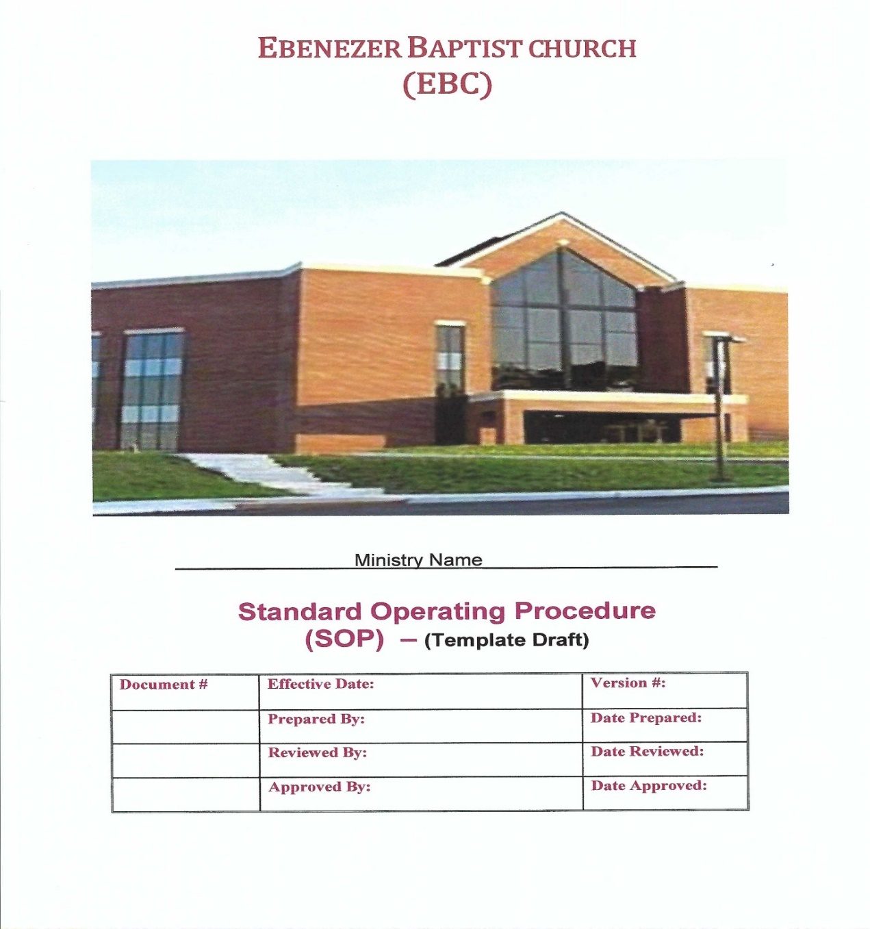
EBC SOP Template

Slide 19
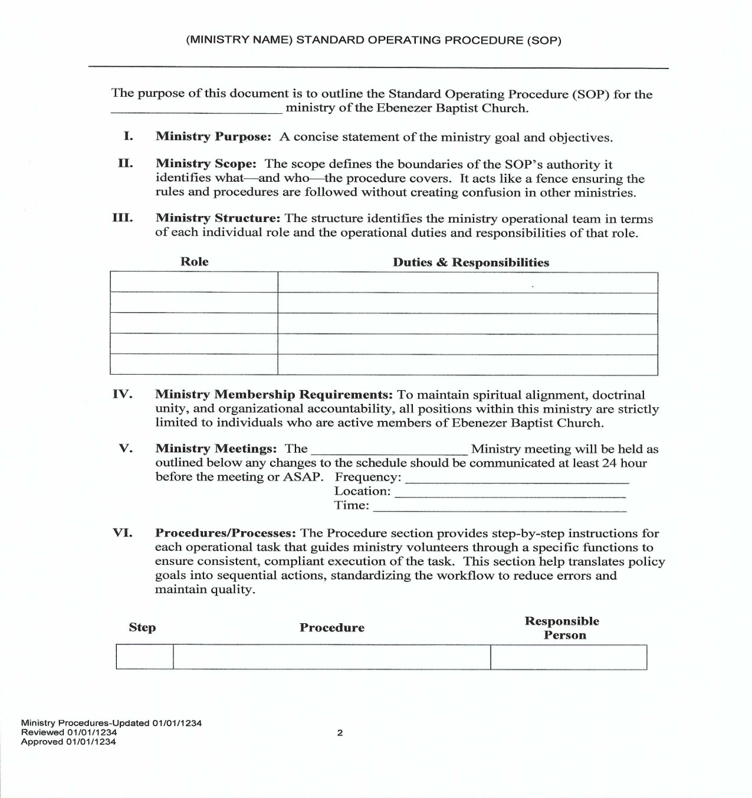
EBC SOP Template

Slide 20
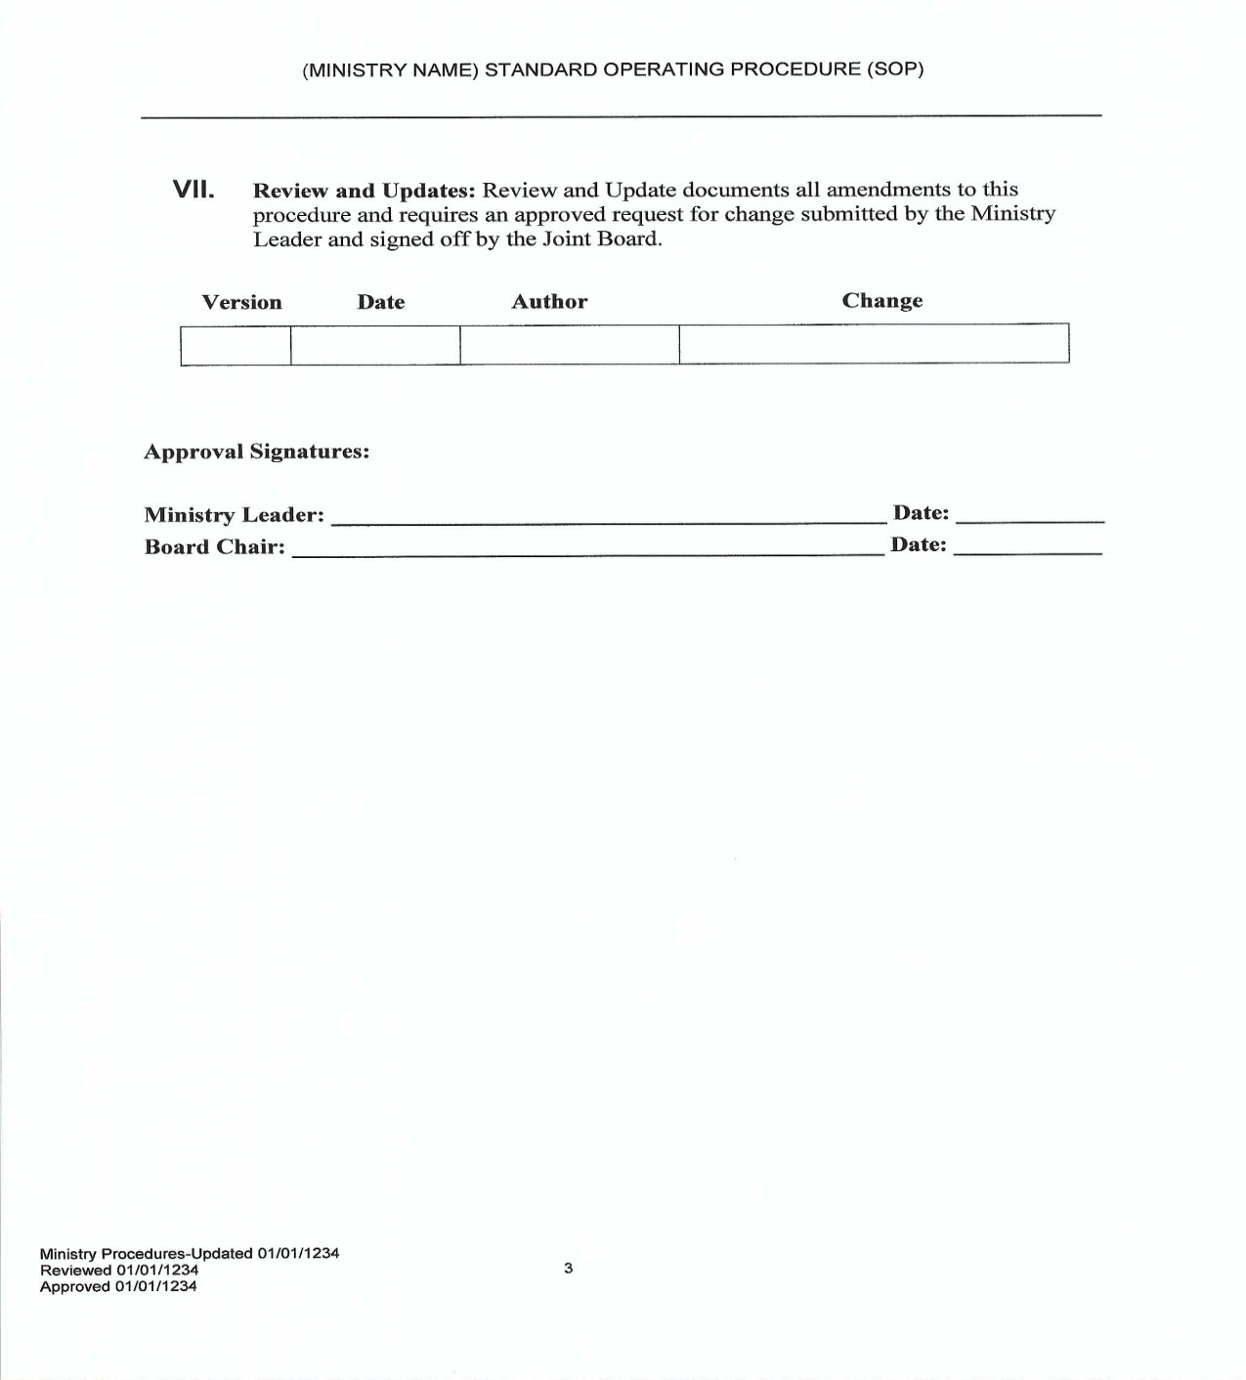
EBC SOP Template

Slide 21
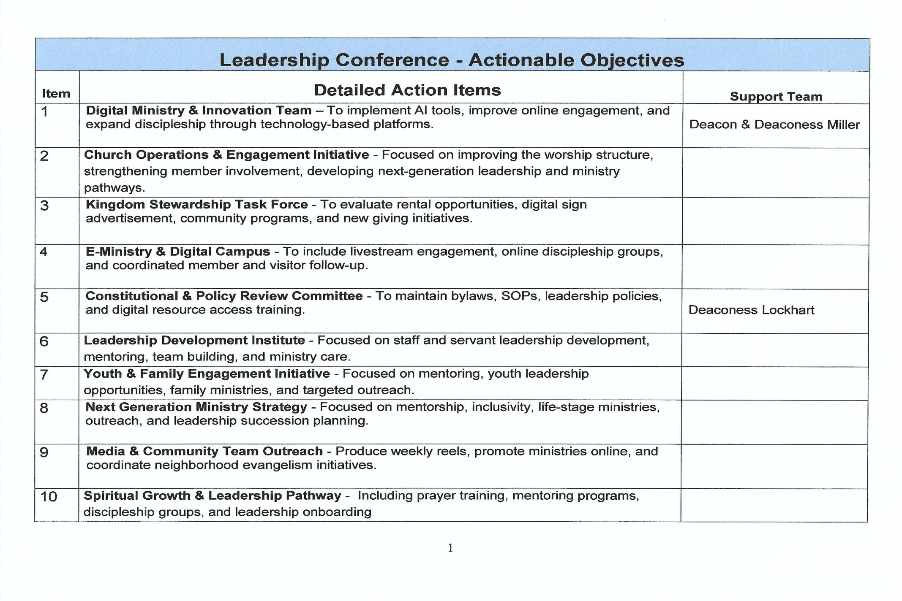
Actionable Objectives Table

Slide 22
Faith – Focused – Forward What’s Next
The next steps include:
Consolidate Notes | √
Identify Strategic Priorities | √
Draft Actionable Objectives | √
Communicate findings | √
Develop Operational Processes (SOP’s)
Assign ownership for Actionable Objectives
Create a Realistic Timeline for Implementation

Slide 23
Faith – Focused – Forward
Leadership Conference Church Meeting
Questions

